Slide 1
Age-Period-Cohort Analysis:
New Models, Methods, and
Empirical Analyses
Kenneth C. Land, Ph.D.
John Franklin Crowell Professor of
Sociology and Demography
Duke University
Presentation
Indiana University
April 15, 2011

Slide 2
GUIDING PRINCIPLE FOR THIS WORK
Famous quote from George E. P. Box, Emeritus Professor of Statistics, University of Wisconsin at Madison:
“All statistical models are wrong, but some are useful.”
Ken Land’s Version:
“All statistical models are wrong, but some have better statistical properties than others – which may make them useful.”

Slide 3
Organization
Briefly Review the Early Literature on Cohort Analysis and the Age-Period-Cohort (APC) Identification Problem
Describe Models & Methods Developed Recently for APC Analysis for Three Research Designs, with Empirical Applications:
  1) APC Analysis of Age-by-Time Period Tables of Rates
  2) APC Analysis of Microdata from Repeated Cross-Section Surveys
  3) Cohort Analysis of Accelerated Longitudinal Panel Designs
Conclusion

Slide 4
Part I: The Early Literature on Cohort Analysis and the Age-Period-Cohort (APC) Identification Problem
Why cohort analysis?
  See the abstract from Norman Ryder’s classic article:
  Ryder, Norman B. 1965. The Cohort as A Concept in the Study of Social Change. American Sociological Review 30:843-861.

Slide 5
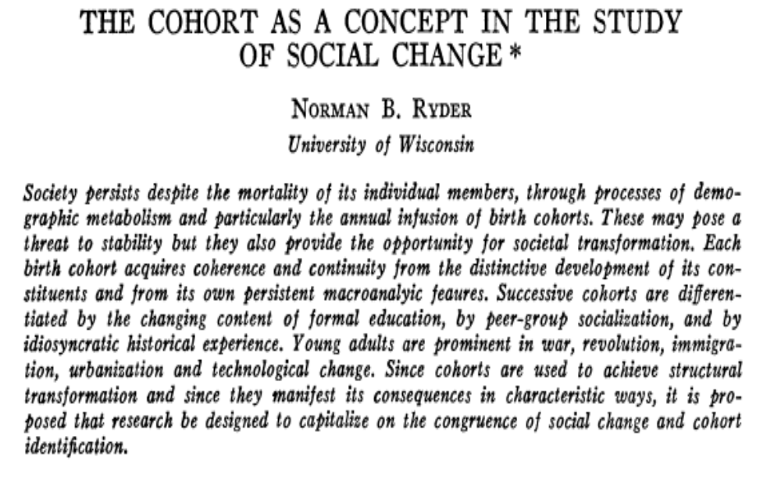
Part I: The Early Literature on Cohort Analysis and the Age-Period-Cohort (APC) Identification Problem

Slide 6
Part I: The Early Literature on Cohort Analysis and the Age-Period-Cohort (APC) Identification Problem
And what is the APC identification problem?
  See the abstract from the classic Mason et al. article:
Mason, Karen Oppenheim, William M. Mason, H. H. Winsborough, W. Kenneth Poole. 1973. Some Methodological Issues in Cohort Analysis of Archival Data. American Sociological Review 38:242-258.

Slide 7
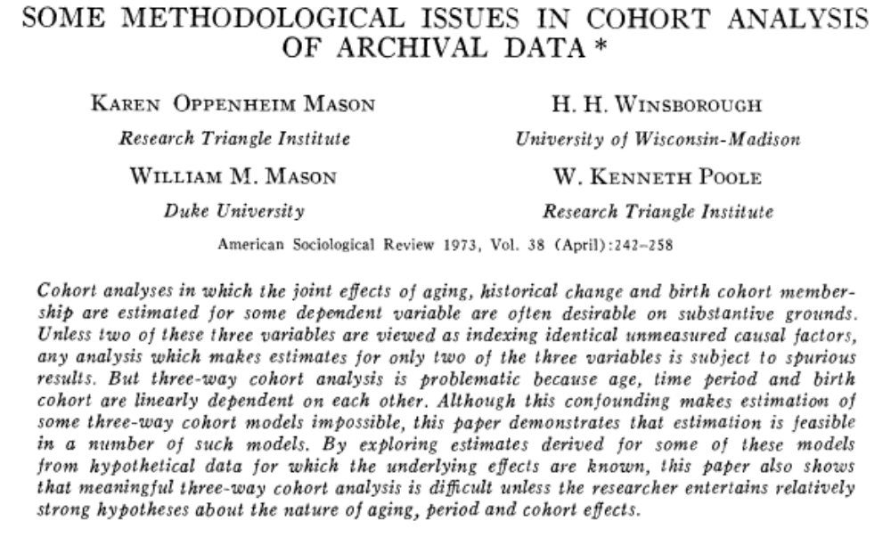
Part I: The Early Literature on Cohort Analysis and the Age-Period-Cohort (APC) Identification Problem

Slide 8
Part I: The Early Literature on Cohort Analysis and the Age-Period-Cohort (APC) Identification Problem
These two articles were particularly important in framing the literature on cohort analysis in sociology, demography, and the social sciences over the past five decades:
Ryder (1965) argued that cohort membership could be as important in determining behavior as other social structural features such as socioeconomic status.
Mason et al. (1973) specified the APC multiple classification/accounting model and defined the identification problem therein.

Slide 9
Part I: The Early Literature on Cohort Analysis and the Age-Period-Cohort (APC) Identification Problem
The Mason et al. (1973) article, in particular, spawned a large methodological literature, beginning with Norval Glenn’s critique:
Glenn, N. D. (1976). Cohort Analysts’ Futile Quest: Statistical Attempts to Separate Age, Period, and Cohort Effects. American Sociological Review 41:900–905.
and Mason et al.’s (1976) reply:
Mason, W. M., K. O. Mason, and H. H. Winsborough. (1976). Reply to Glenn. American Sociological Review 41:904-905.

Slide 10
Part I: The Early Literature on Cohort Analysis and the Age-Period-Cohort (APC) Identification Problem
The Mason et al. reply continued with Bill Mason’s work with Stephen Fienberg:
Fienberg, Stephen E. and William M. Mason. 1978. "Identification and Estimation of Age-Period-Cohort Models in the Analysis of Discrete Archival Data." Sociological Methodology 8:1-67,
which culminated in their 1985 edited volume:
Fienberg, Stephen E. and William M. Mason, Eds. 1985. Cohort Analysis in Social Research. New York: Springer-Verlag,
a defining volume on the methodological literature on APC analysis in the social sciences as of about 25 years ago.

Slide 11
Part I: The Early Literature on Cohort Analysis and the Age-Period-Cohort (APC) Identification Problem
New approaches and critiques thereof continued over the years; see, e.g., an article applying a Bayesian statistics approach:
Saski, M., & Suzuki, T. (1987). Changes in Religious Commitment in the United States, Holland, and Japan. American Journal of Sociology 92:1055–1076,
and the critique:
Glenn, N. D. (1987). A Caution About Mechanical Solutions to the Identification Problem in Cohort Analysis: A Comment on Sasaki and Suzuki. American Journal of Sociology 95:754–761.

Slide 12
Part I: The Early Literature on Cohort Analysis and the Age-Period-Cohort (APC) Identification Problem
For additional material on these and related contributions to the literature on cohort analysis, see the following three reviews:
Mason, William M. and N. H. Wolfinger. 2002. “Cohort Analysis.” Pp. 151-228 in International Encyclopedia of the Social and Behavioral Sciences. New York: Elsevier.
Glenn, Norval D. 2005. Cohort Analysis. 2nd edition. Thousand Oaks: Sage.
Yang, Yang. 2007. “Age/Period/Cohort Distinctions.” Pp. 20-22 in Encyclopedia of Health and Aging. Kyriakos S. Markides (ed). Sage Publications.

Slide 13
Part I: The Early Literature on Cohort Analysis and the Age-Period-Cohort (APC) Identification Problem
Where does this literature on cohort analysis leave us today?
If a researcher has a temporally-ordered dataset and wants to tease out its age, period, and cohort components, how should he/she proceed?
Are there any methodological guidelines that can be recommended?

Slide 14
Part I: The Early Literature on Cohort Analysis and the Age-Period-Cohort (APC) Identification Problem
There are some guidelines – and cautions, e.g., in Glenn (2005).
But can more be done with new statistical models and methods? Perhaps, but any new method must meet the criteria laid down by Glenn (2005: 20) that it may prove useful:
“if it yields approximately correct estimates ‘more often than not,’
if researchers carefully assess the credibility of the estimates by using theory and side information, and
if they keep their conclusions about the effects tentative.”

Slide 15
Part I: The Early Literature on Cohort Analysis and the Age-Period-Cohort (APC) Identification Problem
Generally, however, the problem with much of the extant literature is a deficiency of useful guidelines on how to conduct an APC analysis. Rather, the literature often leads a researcher to conclude either that:
it is impossible to obtain meaningful estimates of the
distinct contributions of age, time period, and cohort to
the study of social change,
or that:
the conduct of an APC analysis is an esoteric art that is
best left to a few skilled methodologists.

Slide 16
Part I: The Early Literature on Cohort Analysis and the Age-Period-Cohort (APC) Identification Problem
Yang and Land and co-authors have bravely taken on Glenn’s challenge and have developed new approaches for APC analysis that are less esoteric and can be used by researchers.
These new approaches are bound together as members of the class of Generalized Linear Mixed Models (GLMMs), models that allow linear and nonlinear exponential family links and mixed (both fixed and random) effects.

Slide 17
Part II: First Research Design: APC Analysis of Age-by-Time Period Tables of Rates or Proportions
References for Part II:
  Fu, W. J. 2000. “Ridge Estimator in Singular Design with Application to Age-Period-Cohort Analysis of Disease Rates.” Communications in Statistics--Theory and Methods 29:263-278.
  Yang Yang, Wenjiang J. Fu, and Kenneth C. Land. 2004. “A Methodological Comparison of Age-Period-Cohort Models: The Intrinsic Estimator and Conventional Generalized Linear Models.” Sociological Methodology 34:75-110.
  Yang Yang, Sam Schulhofer-Wohl, Wenjiang J. Fu, and Kenneth C. Land. 2008. “The Intrinsic Estimator for Age-Period-Cohort Analysis: What It Is and How To Use It.” American Journal of Sociology 114(May): 1697-1736.
  Yang Yang. 2008. “Trends in U.S. Adult Chronic Disease Mortality, 1960-1999: Age, Period, and Cohort Variations.” Demography 45(May):387-416.

Slide 18
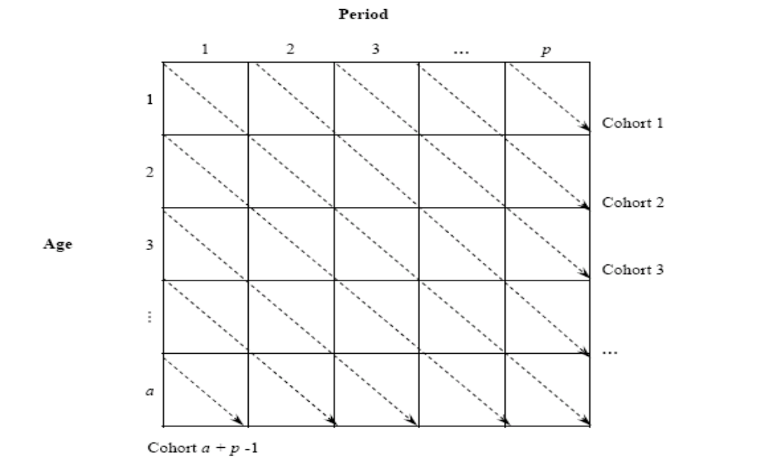
Part II: First Research Design: APC Analysis of Age-by-Time Period Tables of Rates or Proportions
Data Structure: Tabular Rate Data
Notes:
To fix ideas, we focus on the APC analysis of rectangular arrays of demographic rates arranged in a table with age intervals defining the rows and time periods defining the columns. As is conventional in demographic and epidemiological analyses of arrays of this type, both age and period are of five-year interval lengths, so the diagonal elements of the matrices correspond to cohorts.

Slide 19
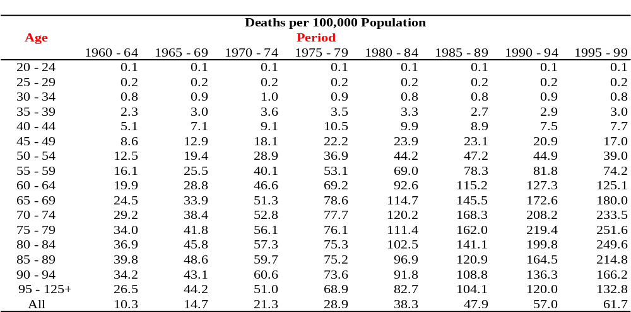
Part II: First Research Design: APC Analysis of Age-by-Time Period Tables of Rates or Proportions
Example: Lung Cancer Death Rates for U.S. Adult Females,
1960 – 1999 Analyzed in Yang (2008)
Source: CDC/NCHS Multiple Cause of Death File
Notes:
For example, Table 1 shows such structure where the entries in the age-period array are lung cancer death Rates for U.S. Adult females: 1960 – 1999. Alternatively, the rates data can be represented by two separate arrays: one for the number of events (counts), the other for the population exposure, and the ratio of these two is the rate. One would need both the numerator and the denominator when fitting a log-linear model of rates.

Slide 20


Part II: First Research Design: APC Accounting/Multiple Classification Model
The Algebra of the APC Identification Problem
  Linear Model Specification:
        (1)
  M_{ij} denotes the observed occurrence/exposure rate of deaths for the i-th age group for i = 1,…,a age groups at the j-th time period for j = 1,…, p time periods of observed data
  D_{ij} denotes the number of deaths in the ij-th group, P_{ij} denotes the size of the estimated population in the ij-th group
  μ denotes the intercept or adjusted mean
  α_{i} denotes the i-th row age effect or the coefficient for the i-th age group
  β_{j} denotes the j-th column period effect or the coefficient for the j-th time period
  γ_{k} denotes the k-th cohort effect or the coefficient for the k-th cohort for k = 1,…,(a+p-1) cohorts, with k=a-i+j
  ε_{ij} denotes the random errors with expectation E(ε_{ij} ) = 0
  Fixed effect GLIM reparameterization: , or setting one of each of the categories
  as the reference group.
Notes:
The Age-Period-Cohort accounting/multiple classification model (Mason, et al. 1973) is a standard approach to the analysis of age-by-time period rates of demographic rates. For mortality rates, this model can be written in linear regression form as (1)

Slide 21


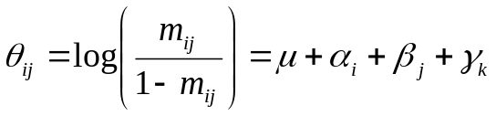
Part II: First Research Design: APC Accounting/Multiple Classification Model
The Algebra of the APC Identification Problem
  Alternative Specifications In the Generalized Linear Models (GLM) Class:
    Simple Linear Models
    where Y_{ij} is the expected outcome in cell (i, j) that is assumed to be normally distributed or equivalently the error term is assumed to be normally distributed with a mean of 0 and variance σ²;
    Log-Linear Models
    log(E_{ij}) = log(P_{ij}) + μ + α_{i} + β_{j} + γ_{k}
    where E_{ij} denotes the expected number of events in cell (i,j) that is assumed to be distributed as a Poisson variate, and log(P_{ij}) is the log of the exposure P_{ij}
    Logistic Models
  where θ_{ij} is the log odds of event and m_{ij} is the probability of event in cell (i,j).
Notes:
Conventional age-period-cohort models as represented in (1) fall into the class of generalized linear models that can take various alternative forms such as the following.

Slide 22



Part II: First Research Design: APC Accounting/Multiple Classification Model
The Algebra of APC Identification Problem
  Least-squares regression in matrix form:
  (2)
  Identification Problem:
  (3)
  The solution to these normal equations does not exist because the
  Design matrix X is singular with 1 less than full rank (one column can be
  written as a linear combination of the others); this is due to the identity:
  Period = Age + Cohort
  thus, (X^{T}X)⁻¹ does not exist
Notes:
The key problem in APC analysis using model (1) is the “identification problem”. Rewriting model (1) in matrix form, we have (2). The OLS estimator is the solution b^ of the normal equations. The linear relationship between the age, period and cohort variables translates to a design matrix, X, that is one less than full column rank. This implies that XTX is singular, i.e., the inverse of XTX does not exist. It follows that solution to normal equations is not unique. Model identification problem exists without assigning certain additional identifying constraints.

Slide 23
Part II: First Research Design: APC Accounting/Multiple Classification Model
Conventional Solutions to APC Identification Problem
  Constrained Coefficients GLIM (CGLIM) Estimator
    Impose one or more equality constraints on the coefficients of the coefficient vector in (2) in order to just-identify (one equality constraint) or over-identify (two or more constraints) the mod
  Proxy Variables/Age-Period-Cohort Characteristic (APCC) Approach
    Use one or more proxy variables as surrogates for the age, period, or cohort coefficients (see O'Brien, R.M. 2000. "Age Period Cohort Characteristic Models." Social Science Research 29:123-139);
  Nonlinear Parametric (Algebraic) Transformation Approach
    Define a nonlinear parametric function of one of the age, period, or cohort variables so that its relationship to others is nonlinear.

Slide 24
Part II: First Research Design: APC Accounting/Multiple Classification Model
Limitations of Conventional Solutions to APC Identification Problem
  Proxy Variables Approach
    the analyst may not want to assume that all of the variation associated with the A, P, or C dimensions is fully accounted for by a proxy variable;
  Nonlinear Parametric (Algebraic) Transformation Approach
    it may not be evident what nonlinear function should be defined for the effects of age, period, or cohort;
  Constrained Coefficients GLIM (CGLIM) Estimator
    it is the most widely used of the three approaches, but suffers from some major problems summarized below.

Slide 25
Part II: First Research Design: APC Accounting/Multiple Classification Model
Limitations of Conventional Solutions to APC Identification Problem
  Constrained Coefficients GLIM (CGLIM) Estimator:
  the analyst desires to employ the flexibility of the APC accounting model with its individual effect coefficients for each of the A, P, or C categories;
  the analyst needs to rely on prior or external information to find constraints that hardly exists or can be well verified;
  different choices of identifying constraints can produce widely different estimates of patterns of change across the A, P, and C categories of the analysis;
  all just-identified CGLIM models will produce the same levels of goodness-of-fit to the data, making it impossible to use model fit as the criterion for selecting the best constrained model.

Slide 26
Part II: First Research Design: APC Accounting/Multiple Classification Model
So, what can be done? Some Guidelines for Estimating APC Models for Tables of Rates or Proportions
  Step 1: Descriptive data analyses using graphics
  Step 2: Model specification tests
  Objectives:
  to provide qualitative understanding of patterns of age, or period, or cohort variations, or two-way age by period and age by cohort variations;
  to ascertain whether the data are sufficiently well described by any single factor or two-way combination of the A, P, and C dimensions or if it is necessary to include all three.

Slide 27
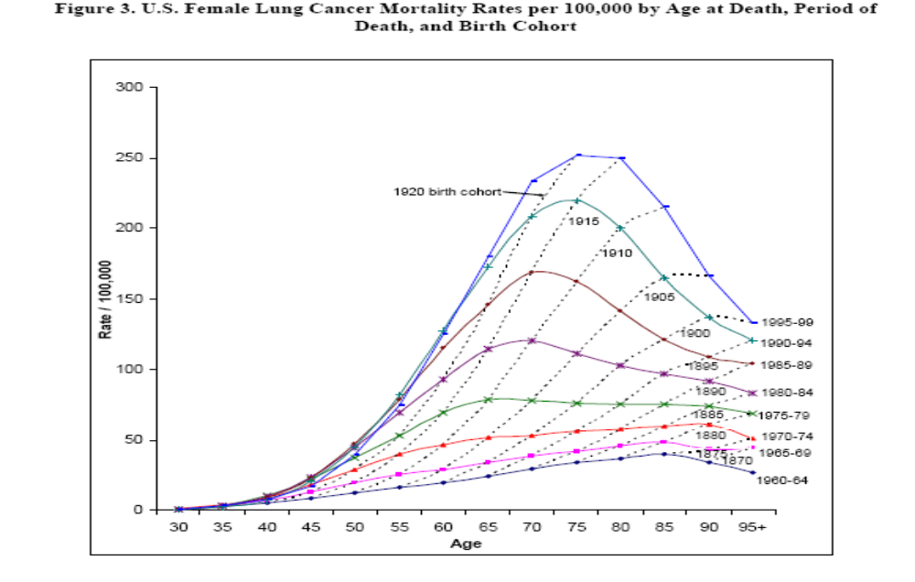
Part II: First Research Design: APC Accounting/Multiple Classification Model
Step 1: Graphical analyses: Female Lung Cancer Example from Yang (2008)
Notes:
This figure of age-period-specific rates shows increased in lung cancer mortality with age after early adulthood over the 40-year period; large increases by cohort as well. Cohort effects can be interpreted as a special form of interaction effect between the categorical age and period variables, cohort effects can be detected by plots of age-specific death rates by time period and a lack of parallelism among these curves suggest birth cohort effects that are operating. The same applies to period effect as a particular type of age-cohort interaction.

Slide 28
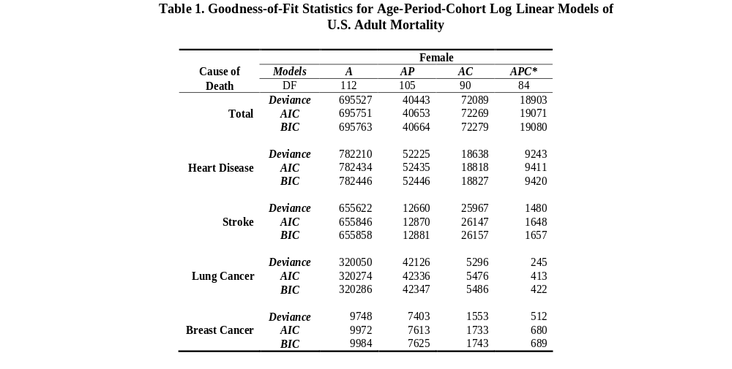
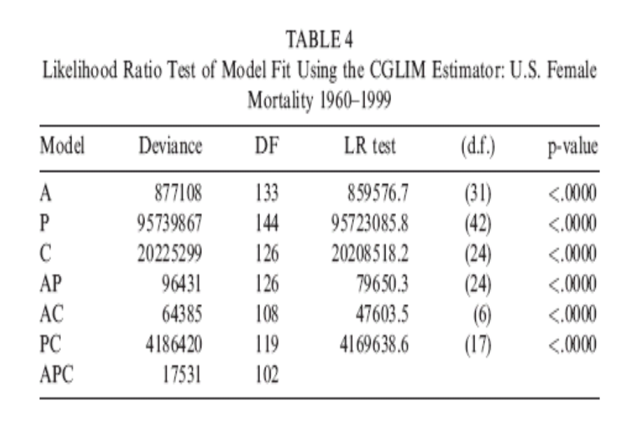
Part II: First Research Design: APC Accounting/Multiple Classification Model
Step 2: Model selection procedures
  Examples from Yang et al. (2004) and Yang (2008)
Notes:
Determine the relative importance of the A, P, and C dimensions by comparing overall measures of model fit (e.g., R-squared for linear regression models or deviance statistics/penalized likelihood functions like BIC for generalized linear models)

Slide 29
Part II: First Research Design: APC Accounting/Multiple Classification Model
Guidelines for Estimating APC Models of Rates or Proportions
If the foregoing descriptive analyses suggest that only one or two of the A, P, and C dimensions is operative, then the analysis can proceed with a reduced model (2) that omits one or two dimensions and there is no identification problem.
If, however, these analyses suggest that all three dimensions are at work, then Yang et al. (2004, 2008) recommend:
Step 3: Apply the Intrinsic Estimator (IE).

Slide 30
Part II: First Research Design: APC Accounting/Multiple Classification Model
What is the Intrinsic Estimator (IE)?
  It is a new method of estimation that yields a unique solution to the model (2) and is the unique estimable function of both the linear and nonlinear components of the APC model determined by the Moore-Penrose generalized inverse. It achieves model identification with minimal assumptions.
Why is the IE useful?
  The basic idea of the IE is to remove the influence of the design matrix (which is fixed by the number of age and period groups and not related to the outcome observations Y_{ij}) on coefficient estimates. This constraint produces estimates that have desirable statistical properties.
Notes:
So what is new about the Intrinsic Estimator (IE)?

Slide 31
Part II: First Research Design: APC Accounting/Multiple Classification Model
Some preliminary matrix algebra concepts:
Let A be a matrix of dimension q by d (q rows and d columns), let x be a column vector of dimension d, and y a column vector of dimension q.
For a set of linear equations Ax = y, the set of vectors x₀ of (real) numbers such that Ax₀ = 0 is called the null space of the matrix A.
When a matrix A is rank deficient (has linearly dependent columns), the dimension of the null space is at least one.
In this case, if we have Ax = y, then we also have A(x + x₀) = y.
When A is rank deficient, the equation Ax = y has an infinite set of solutions, which differ by an element of the null space (if vectors x₁ and x₂ are solutions, then A(x₁ – x₂) = 0 and the vector x₁ – x₂ is in the null space).
When A is rank deficient, there always is a well-defined solution whose projection on the null space is zero; this solution corresponds to the generalized inverse of A.

Slide 32

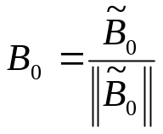

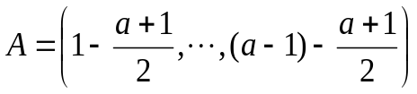
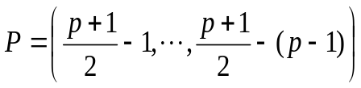
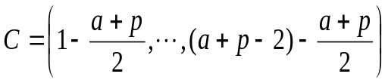
Part II: First Research Design: APC Accounting/Multiple Classification Model
The Intrinsic Estimator (IE): Algebraic Definition
  The linear dependency between A, P, and C in model (2) is mathematically equivalent to:
  (4)
  which defines the null space for model (2) where the eigenvector B₀ of eigenvalue of 0 is fixed by the design matrix X:
Notes:
The structure and the estimability of the IE can be shown in the following:
1) The exact linear dependency between age, period, and cohort variables is mathematically equivalent to (3); where B₀ is the normalized eigenvector of the singular design matrix X corresponding to the unique eigen value 0. It is important to note that the vector B0 is fixed because it is a function solely of the number of age groups (a) and periods (p). The fact that it is independent of the response variable Y suggests that it should not play any role in the estimation of effect coefficients and can be removed.

Slide 33



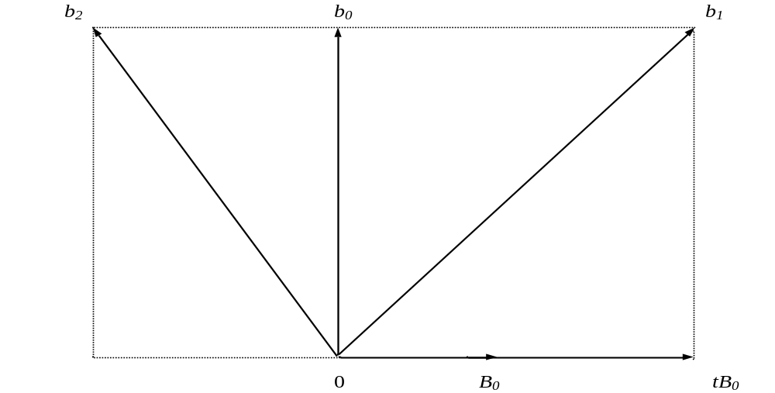
Part II: First Research Design: APC Accounting/Multiple Classification Model
The Intrinsic Estimator (IE): Algebraic Definition
  Parameter vector orthogonal decomposition:
  (5)
  (6)
  where is the projection of b to the non-null space of X
  and t is a real number, tB₀ is in the null space of X and represents
  trends of linear constraints – Different equality constraints used by
  CGLIM estimators, such as b₁ and b₂, yield different values of t.
Notes:
2) The parameter space of the unconstrained vector b of the linear model (2) can be decomposed into two parts that are orthogonal or independent to each other: (4)
The special parameter vector b0 corresponding to t = 0 satisfies the geometric projection: (5) It is this special parameter vector that IE estimates.

Slide 34


Part II: First Research Design: APC Accounting/Multiple Classification Model
The Intrinsic Estimator (IE) Method: Algebraic Definition
  From the infinite number of estimators of b in model (2):
(7)
  the IE B estimates the parameter vector b₀ corresponding to t = 0:
(8)
  The IE is the special estimator that uniquely determines the age, period, and cohort effects in the parameter subspace defined by b₀ :
      (9)
Notes:
3) The decomposition of parameter vector b means that each of the infinite number of possible estimators of parameter vector b, denoted as b^, can be written as a linear combination: (6)
where B is the IE that estimates b0. Different linear constraints on coefficients of the b vector assign different values to t and lead to different estimates. The IE is free of such variation by setting t = 0 and can be obtained using the projection: (7). This shows that the IE B is the special estimator that uniquely determines the age, period, and cohort effects in the parameter subspace.

Slide 35
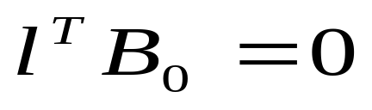
Part II: First Research Design: APC Accounting/Multiple Classification Model
The Intrinsic Estimator (IE) Method: Desirable statistical properties (Yang et al. 2004, 2008):
Estimability: Yang et al. (2004) established that the IE satisfies the Kupper et al. (1985) condition for estimability, namely
where where l^{T} is a constraint vector (of appropriate dimension) that defines a linear function l^{T}b of b.
Reference:
Kupper, L.L., J.M. Janis, A. Karmous, and B.G. Greenberg. 1985. “Statistical Age-Period-Cohort Analysis: A Review and Critique.” Journal of Chronic Disease 38:811-830.

Slide 36
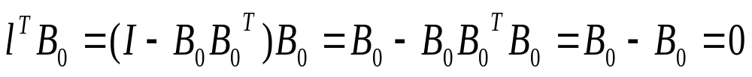
Part II: First Research Design: APC Accounting/Multiple Classification Model
Proof: Note that
Estimable functions are desirable as statistical estimators because they are linear functions of the unidentified parameter vector that can be estimated without bias, i.e., they have unbiased estimators.

Slide 37
Part II: First Research Design: APC Accounting/Multiple Classification Model
Yang et al. (2004) also proved independently of the Kupper et al. (1985) estimability condition that the IE has the following two properties:
2) Unbiasedness: For a fixed number of time periods of data, it is an unbiased estimator of the special parameterization (or linear function) b₀ of b.
3) Relative efficiency: For a fixed number of time periods of data, it has a smaller variance than any CGLIM estimators.

Slide 38


Part II: First Research Design: APC Accounting/Multiple Classification Model
3) Asymptotic consistency: This properties derive largely from the fact that the length of the eigenvector B₀ decreases with increasing numbers of time periods of data, and, in fact, converges to zero as the number of periods of data increases without bound.
Therefore, for any two estimators:
and
where t₁ and t₂ are nonzero and correspond to different identifying constraints, as the number of time periods in an APC analysis increases, the difference between these two estimators decreases towards zero, and, in fact, that the estimators converge toward the IE B.

Slide 39
Part II: First Research Design: APC Accounting/Multiple Classification Model
4) Monte Carlo Simulation: Numerical simulation demonstrations of the foregoing statistical properties were given in Yang et al. (2008); one example is reproduced on the following slide.

Slide 40
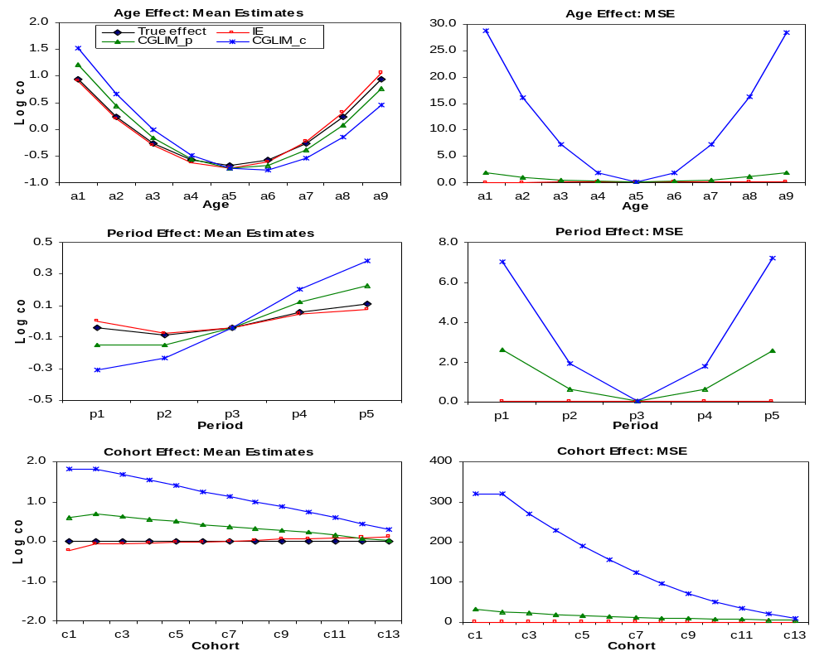
Simulation Results of the IE and CGLIM Estimators: True Cohort Effects = 0

Slide 41
Part II: First Research Design: APC Accounting/Multiple Classification Model
Based on these statistical properties, Yang et al. (2008) also showed how the IE can be used in an asymptotic t-test to evaluate a substantively informed equality constraint on the APC accounting model with respect to whether the estimated coefficient vector that results therefrom is (statistically) estimable, that is, within sampling error of meeting the Kupper et al. condition for estimability.

Slide 42
Part II: First Research Design: APC Accounting/Multiple Classification Model
The Intrinsic Estimator (IE) Method: Computation Software
Two programs for calculating the IE are available for use in popular statistical packages:
a S-Plus/R program
and
a Stata Ado File
(both referenced in Yang et al., 2008)
Notes:
Programs for estimating the IE have been written as add-on files to two commercially available software packages, S-Plus and Stata.

Slide 43
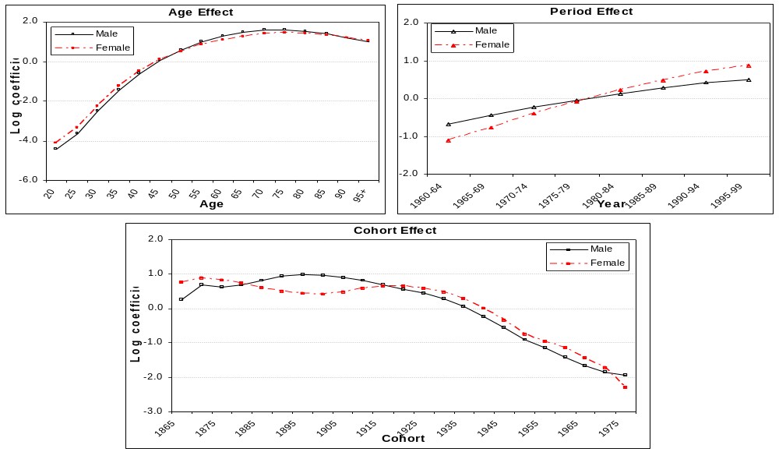
Part II: First Research Design: APC Accounting/Multiple Classification Model
Example: Intrinsic Estimates of Age, Period, and Cohort Effects of Lung Cancer Mortality by Sex (Yang 2008)
Notes:
This figure shows the coefficient estimates using the IE on the lung cancer mortality data by sex.

Slide 44
Some Recent Empirical Applications of the Intrinsic Estimator:
Schwadel, P. 2011. “Age, period, and cohort effects on religious activities and beliefs”, Social Science Research 40:181-192.
Unknown Author. 2011. “Age, Period, and Cohort Effects on Social Capital and Voting.” Social Forces 90:forthcoming.
Winkler, Richelle L., Jennifer Huck, and Keith Warnke. 2009. “Deer hunter demography: An age-period-cohort approach to population projections.” Paper presented at the Population Association of America Annual Meeting, Detroit, MI, April 30, 2009.

Slide 45
Part II: First Research Design: APC Accounting/Multiple Classification Model
The Intrinsic Estimator (IE): Conclusion
Is the Intrinsic Estimator a “final” or “universal” solution to the APC “conundrum”?
No. There will never be such a solution. The APC identification problem is one of structural under-identification in linear or generalized linear models for which there can only be partial solutions.
But the IE has been shown to be a useful approach to the identification and estimation of the APC accounting model that
    has desirable mathematical and statistical properties; and
    has passed both case studies and simulation tests of model validation.

Slide 46
Part III: Second Research Design: APC Analysis of Repeated Cross-Section Surveys
References for Part III:
Yang, Yang. 2006. Bayesian Inference for Hierarchical Age-Period-Cohort Models of Repeated Cross-Section Survey Data. Sociological Methodology 36:39-74.
Yang Yang and Kenneth C. Land. 2006. A Mixed Models Approach to the Age-Period-Cohort Analysis of Repeated Cross-Section Surveys, With an Application to Data on Trends in Verbal Test Scores. Sociological Methodology 36:75-98.
Yang Yang and Kenneth C. Land. 2008. Age-Period-Cohort Analysis of Repeated Cross-Section Surveys: Fixed or Random Effects? Sociological Methods and Research 36(February):297-326.
Yang, Yang 2008. “Social Inequalities in Happiness in the United States, 1972 to 2004: An Age-Period-Cohort Analysis.” American Sociological Review 73(April): 204-226.

Slide 47
Part III: Second Research Design: APC Analysis of Repeated Cross-Section Surveys
References for Part III, Continued:
Yang Yang, Steven M. Frenk, and Kenneth C. Land. 2010. “Assessing
the Significance of Cohort and Period Effects in Hierarchical Age-Period-Cohort Models.” Revision of a paper presented at the American Sociological Association Annual Meeting, San Francisco, CA, August 2009.
Zheng, Hui, Yang Yang, and Kenneth C. Land. 2011. “Heteroscedastic Regression in Hierarchical Age-Period-Cohort Models, With Applications to the Study of Self-Reported Health. Revision of a paper presented at the American Sociological Association Annual Meeting, Atlanta, GA, August 2010.

Slide 48
Part III: Second Research Design: APC Analysis of Repeated Cross-Section Surveys
Data Structure: Individual-level Data in an Age-by-Period Array
Period j
n_{ij} >1
Age i
Notes:
We now turn to a second common research design for which APC analysis is salient—repeated cross-section sample surveys, such as the General Social Survey.

Slide 49
Part III: Second Research Design: APC Analysis of Repeated Cross-Section Surveys
Approach to the Identification Problem
Many researchers previously have assumed that the APC identification problem for age-by-time period tables of rates transfers over directly to this research design.
But note that this research design yields individual-level data, i.e., microdata on the ages and other characteristics of individuals in the samples.
Proposal: Use different temporal groupings for the A, P, and C dimensions to break the linear dependency:
    Single year of age
    Time periods correspond to years in which the surveys are conducted
    Cohorts can be defined either by five- or ten-year intervals that are conventional in demography or by application of a substantive classification (e.g., War babies, Baby Boomers, Baby Busters, etc.).

Slide 50
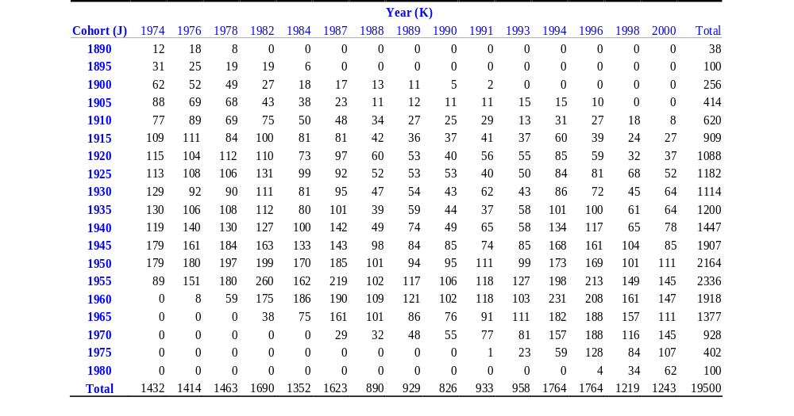
Part III: Second Research Design: APC Analysis of Repeated Cross-Section Surveys
Example: Two-way Cross-Classified Data Structure in the GSS: Number of Observations by Cohort and Period in the Verbal Ability Data (Yang and Land 2006)
Notes:
It seems the analysis can then could proceed by application of conventional regression or GLIM analysis. But this ignores the multilevel structure of the data designs.
For example, the multi-level data structure is evident here in this table

Slide 51
Part III: Second Research Design: APC Analysis of Repeated Cross-Section Surveys
This Data Structure illustrates that:
  respondents are nested in and cross-classified simultaneously by the two higher-level social contexts defined by time period and birth cohort,
  individual members of any birth cohort can be interviewed in multiples replications of the survey, and
  individual respondents in any particular wave of the survey can be drawn from multiple birth cohorts.
  Key Points:
  this approach builds on the recognition that age is an intrinsically individual-level property that individuals carry with them and that varies from period to period;
  2) by comparison an individual’s cohort is fixed, as is the time period of a particular survey, and both cohort and period are contexts within which individuals mature and age and experience certain events.

Slide 52
Part III: Second Research Design: APC Analysis of Repeated Cross-Section Surveys
Further Questions:
  Is there evidence for clustering effects of random errors, due to the facts that:
    individuals surveyed in the same year may be subject to similar unmeasured events that influence their outcomes, and
    members of the same birth cohort may be subject to similar unmeasured events that influence their outcomes?
  How can this random variability be modeled and explained?

Slide 53
Part III: Second Research Design: APC Analysis of Repeated Cross-Section Surveys
Method: Apply Hierarchical Age-Period-Cohort (HAPC) Models
These models generally are members of what statisticians call mixed (fixed and random) effects models; in the social sciences, these models typically are called hierarchical linear models (HLM).
The mixed models may be linear mixed effects (LMM) models or, more generally, allow for nonlinear link functions, in which case they are generalized linear mixed models (GLMM).
A form of HLMs applicable to cross-classified data of the form shown above is the class of cross-classified random effects models (CCREM).
Objective: Model the level-two heterogeneity to:
Assess the possibility that individuals within the same periods and cohorts could share unobserved random variance;
Explain the level-two variance by contextual characteristics of time periods and birth cohorts.
Notes:
If there is level-two heterogeneity, then the assumption of fixed period and cohort effects ignores this heterogeneity and may not be adequate.

Slide 54
Part III: Second Research Design: APC Analysis of Repeated Cross-Section Surveys
Application 1 – A HAPC-LMM of General Social Survey (GSS) Data on Verbal Test Scores: 1974 – 2006
The Initial Papers:
Alwin, D. 1991. “Family of Origin and Cohort Differences in Verbal Ability.” American Sociological Review 56:625-38.
Glenn, N.D. 1994 “Television Watching, Newspaper Reading, and Cohort Differences in Verbal Ability.” Sociology of Education 67:216-30.
The debate in the American Sociological Review:
Wilson, J.A. and W.R. Gove. 1999. "The Intercohort Decline in Verbal Ability: Does It Exist?" and reply to Glenn and Alwin & McCammon. ASR 64:253-266, 287-302.
Glenn, N.D. 1999. “Further Discussion of the Evidence for An Intercohort Decline in Education-Adjusted Vocabulary.” ASR 64:267-71.
Alwin, D.F. and R.J. McCammon. 1999. “Aging Versus Cohort Interpretations of Intercohort Differences in GSS Vocabulary Scores.” ASR 64:272-86.

Slide 55
Part III: Second Research Design: APC Analysis of Repeated Cross-Section Surveys
Research Questions
  What are the distinct age, period, and cohort components of change in verbal ability in the U.S.?
  How can period and/or cohort level heterogeneity be explained by period and/or cohort characteristics?
Analytic Method
  Apply the HAPC-CCREM to estimate
    fixed effects of age and other individual level and level-two covariates,
    random effects of period and cohort and variance components

Slide 56
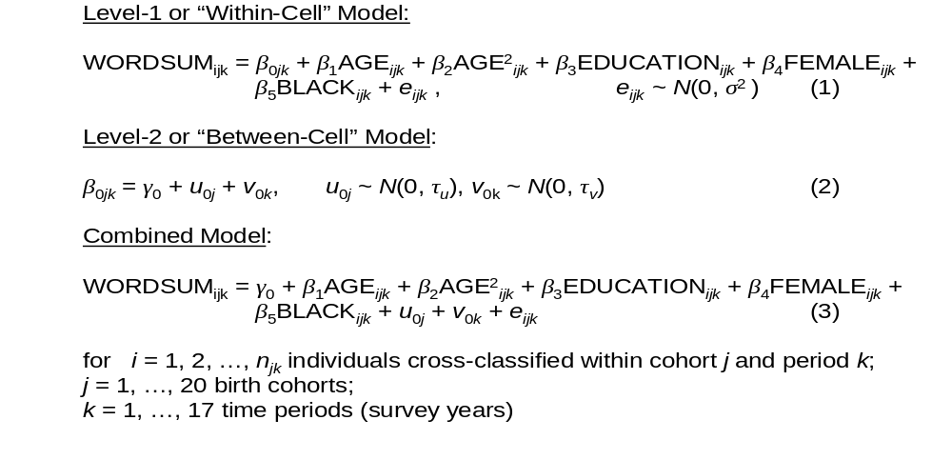
Part III: Second Research Design: APC Analysis of Repeated Cross-Section Surveys
Because the WORDSUM outcome variable has a relatively bell-shaped sample frequency distribution, it is reasonable to use a HAPC model specification that includes a conventional normal-errors regression model. Specifically, Yang and Land (2006: 87) specified the cross-classified random effects model (CCREM):

Slide 57
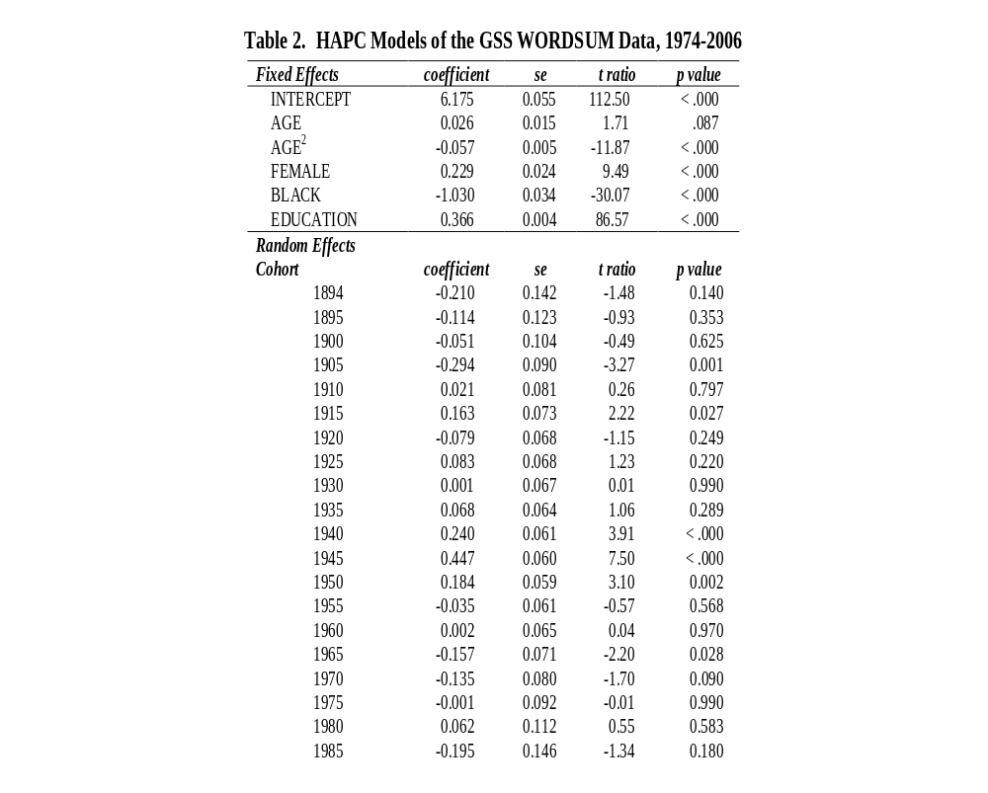

Slide 58
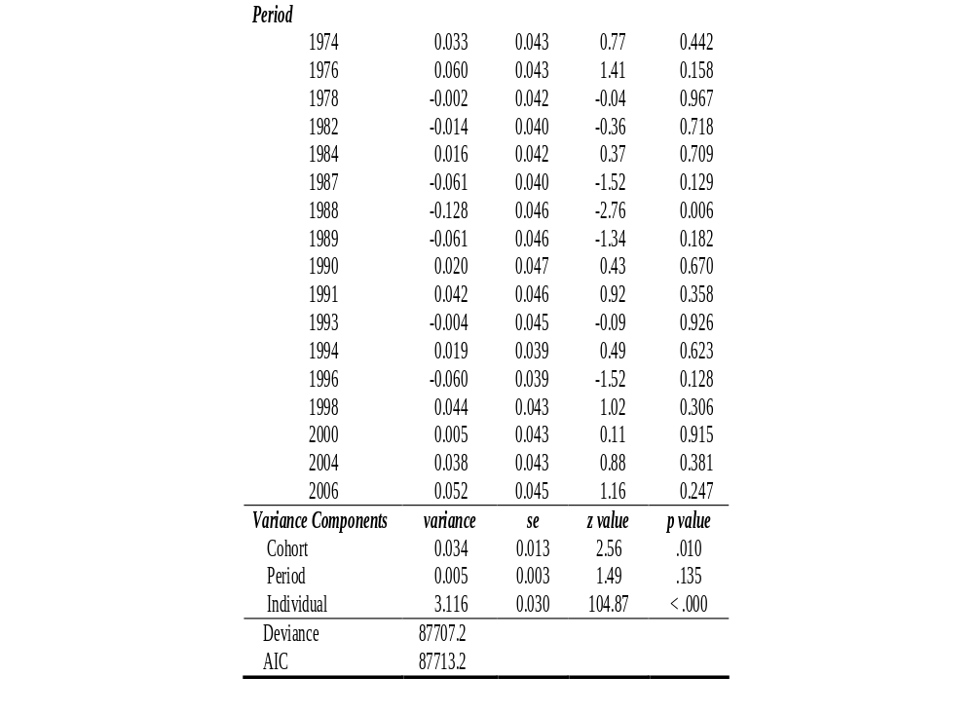

Slide 59
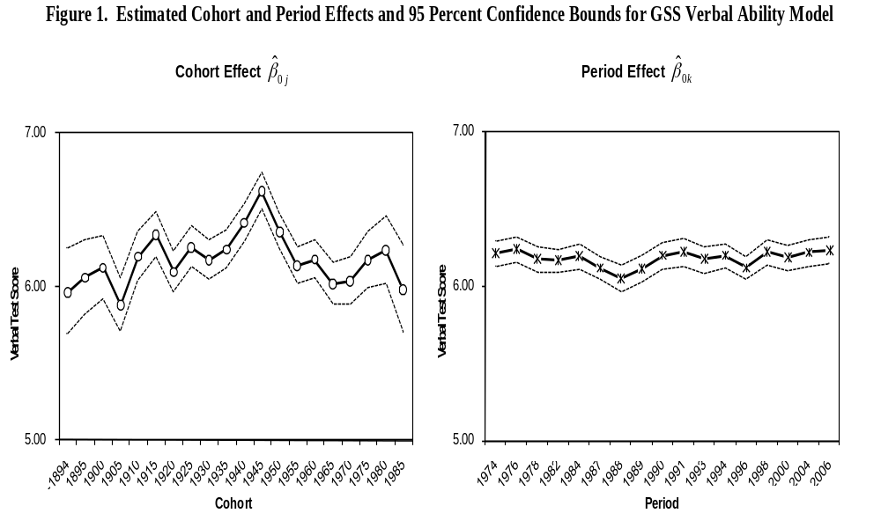

Slide 60
To further test whether the birth cohort and time period effects – as a whole – make statistically significant contributions to explained variance in an outcome variable, a general linear hypothesis may be applied.
Specifically, one can either:
examine the statistical significance of the variance components (an asymptotic t-test for LMMs), or
use an F test to test the hypothesis of the presence of random effect.
The sampling distribution of F statistic is exact in LMMs when the random effects are independently distributed as normal random variables.
This F-test statistic is preferred over the z-score when the sample sizes for random effects are small. The statistical theory for such tests has been developed in a very general LMM context by E. Demidenko (Mixed Models: Theory and Applications. Wiley, 2004).

Slide 61
In the present case, for the CCREM-HAPC model of Equations (1)-(3), there are only two sets of random effect coefficient that are estimated, namely, the set of residual random effects of cohort j, u_{0j}, and the set of residual random effects of period k, v_{0k}. Each of these sets of random coefficients is assumed to be independently, normally distributed with mean 0 and variances τ_{u} and τ_{v}, respectively.
Thus, for a CCREM-HAPC model with random intercepts of the form of Equations (1)-(3), the exact F-test amounts to testing null hypotheses for the relevance either of the birth cohort random effects:
H₀: τ_{u} = 0, vs. H_{a}: τ_{u} > 0
or the time period effects:
H₀: τ_{v} = 0, vs. H_{a}: τ_{v} > 0.
Alternatively, one can test for the joint relevance of both the cohort and period effects:
H₀: τ_{u} = τ_{v} = 0, vs. H_{a}: τ_{u} > 0 or τ_{v} > 0

Slide 62
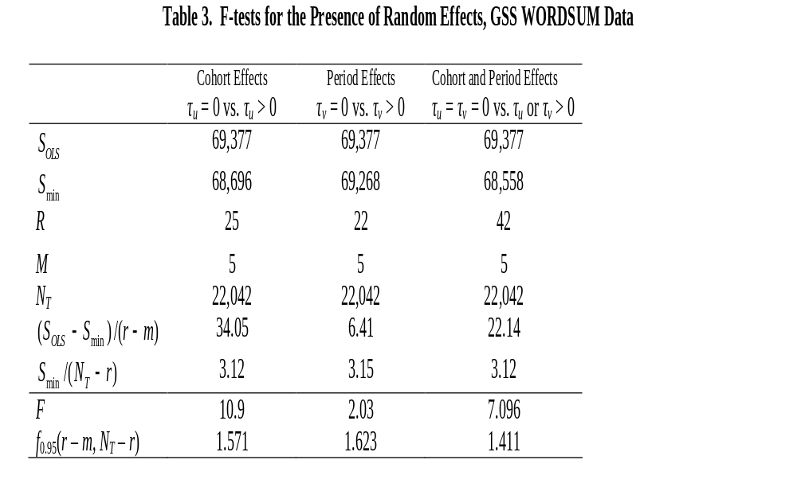

Slide 63
Part III: Second Research Design: APC Analysis of Repeated Cross-Section Surveys
BACK TO THE DEBATE ON TRENDS IN VERBAL ABILITY:
So, who is right, Alwin and Glenn or Wilson and Gove?
The results of the HAPC analyses show:
  significant random variance components that reside in all three levels of the APC data: individuals nested within cohorts and periods;
  quadratic age effects that are not explained away by controlling for the effects of key individual characteristics, namely, education, sex and race, and for period and cohort effects;
  significant contextual effects of cohorts and periods on verbal ability, but this is mainly a cohort story; and
  strong effects of cohort characteristics: cohorts that have a larger proportion of daily newspaper readers are better off in their verbal ability; more hours of TV watching per day tend to undermine average cohort verbal ability.
  Bottom Line: Alwin and Glenn are more right than Wilson and Gove.

Slide 64
Part III: Second Research Design: APC Analysis of Repeated Cross-Section Surveys
Extensions of HAPC Modeling:
  Fixed Effects vs. Mixed Effects Model
  A Full Bayesian HAPC Model
  Generalized Linear Mixed Models (GLMM)
Notes:
HAPC models provide a framework for analysis of repeated cross-sectional data and can be extended to take into account a number of problems. And we will focus on three extensions here.

Slide 65
Part III: Second Research Design: APC Analysis of Repeated Cross-Section Surveys
Fixed Effects vs. Mixed Effects Model:
  The HAPC-CCREM approach illustrated above uses a mixed (fixed and random) effects model with a random effects specification for the level-2 (time period and cohort) contextual variables.
  Alternative: fixed effects specification for the level-2 variables in which ones uses dummy (indicator) variables to record the cohort and the time period of the survey.
  The comparison seems especially pertinent when the number of replications of the survey is relatively small—say 3 to 5.

Slide 66
Part III: Second Research Design: APC Analysis of Repeated Cross-Section Surveys
Fixed Effects vs. Mixed Effects Model:
  The estimates of cohort and time period effects from a fixed effects model for the GSS data are quite similar in pattern to those from the random effects model (Yang and Land 2008).
  The mixed effects model is preferred to the fixed effect model:
    It avoids potential model specification error by not using the assumption of the fixed effect model that the indicator/dummy variables representing the fixed cohort and periods effects fully account for all of the group effects;
    It allows group level covariates to be incorporated into the model and explicitly models cohort characteristics and period events to test explanatory hypotheses;
    For unbalanced research designs (designs in which there are unequal numbers of respondents in the cells), such as one typically has in repeated cross-section survey designs, a random effect model for the level-2 variables generally is more statistically efficient.

Slide 67
Part III: Second Research Design: APC Analysis of Repeated Cross-Section Surveys
A Full Bayesian HAPC Model:
  Limitations of HAPC Modeling Using REML-EB Estimation
    Small numbers of cohorts (J) and periods (K)
    Unbalanced data
    Inaccurate REML estimates of variance-covariance components
    Inaccurate EB estimates of fixed effects regression coefficients
  A Remedy: Bayesian Model Estimation (Yang 2006)
    A full Bayesian approach, by definition, ensures that inferences about every parameter fully account for the uncertainty associated with all others.
Notes:
In APC analyses of finite time period social survey data, the numbers of periods and birth cohorts usually are too small to satisfy the large sample criteria required by the maximum likelihood estimation of variance components. In addition, the sample sizes within each cohort are highly unbalanced. Therefore, errors in variance components estimates may produce extra uncertainty in fixed effects coefficient estimates that will not be reflected in the standard errors.

Slide 68
Part III: Second Research Design: APC Analysis of Repeated Cross-Section Surveys
Application 2: A HAPC-GLMM of American National Election Survey (ANES) Data on Voting Turnout in U.S. Presidential Elections, 1952-2004 (Yang, Frenk, and Land 2010)
  The GLMM Family of Models:
    Normal outcome: Linear mixed models using Gaussian link
    Binomial outcome: Logistic mixed models using logit link
    Ordinal or nominal outcome: Ordinal logistic mixed models
    Count outcome: Poisson mixed models using log link
    Count outcome with dispersion: Negative Binomial mixed models
  REML-EB Estimation: Use, e.g., SAS PROC GLIMMIXED

Slide 69
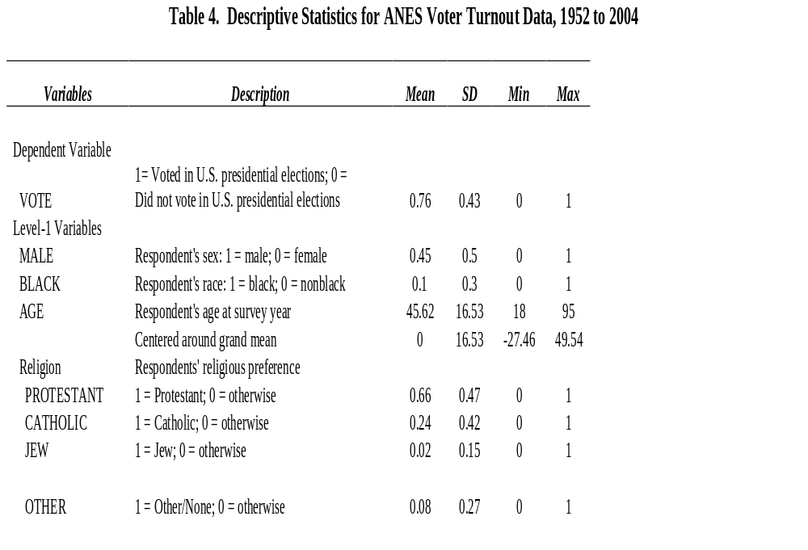
Application 2: A HAPC-GLMM of Voting Turnout in U.S. Presidential Elections

Slide 70
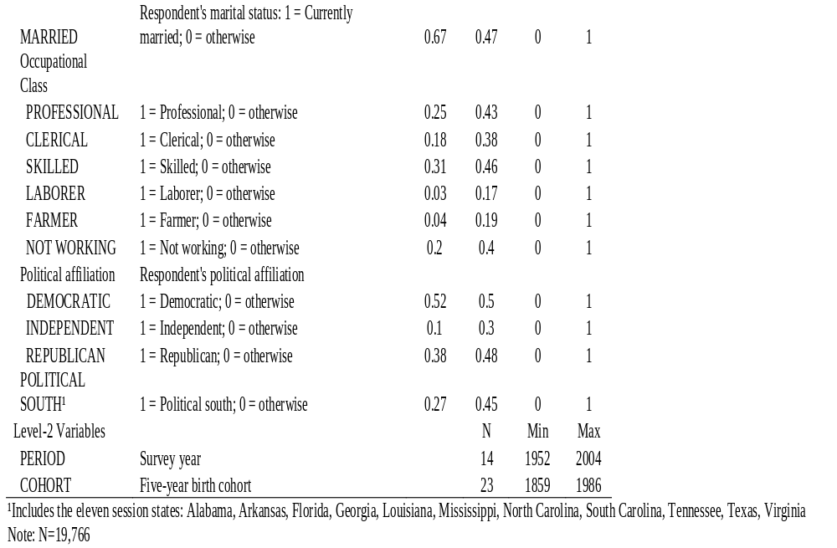

Slide 71
To model the likelihood of voter turnout in U.S. Presidential Elections, we apply the HAPC-CCREM approach and specify the following model:
Level 1 or “Within-Cell” Model:
Pr (VOTEijk = 1) = β0jk + β1AGEijk + β2AGE2ijk + β3MALEijk + β4BLACKijk + β5PROTESTANTijk + β6CATHOLICijk + β7JEWijk + β8PROFESSIONALijk + β9CLERICALijk + β10SKILLEDijk + β11FARMERijk + β12NOWORKijk + β13PSOUTHijk + β14CMARRIEDijk + β15DEMOCRATICijk + β16REPUBLICANijk
Level 2 or “Between-Cell” Model:
β0jk = γ0 + u0j + ν0k , u0j ~ N(0, τu), ν0k ~ N(0, τv)
COMBINED MODEL:
Pr (VOTEijk = 1) = β0jk + β1AGEijk + β2AGE2ijk + β3MALEijk + β4BLACKijk + β5PROTESTANTijk + β6CATHOLICijk + β7JEWijk + β8PROFESSIONALijk + β9CLERICALijk + β10SKILLEDijk + β11FARMERijk + β12NOWORKijk + β13PSOUTHijk + β14CMARRIEDijk + β15DEMOCRATICijk + β16REPUBLICANijk + u0j + ν0k + eijk (12)
for i = 1, 2, …, njk individual within cohort j and period k;
j = 1, …23 birth cohorts;
k = 1, …, 14 time periods (presidential elections).

Slide 72
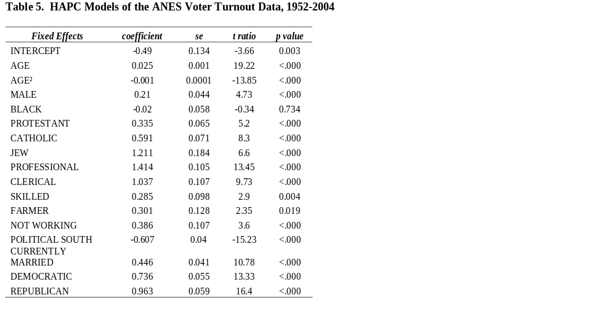

Slide 73
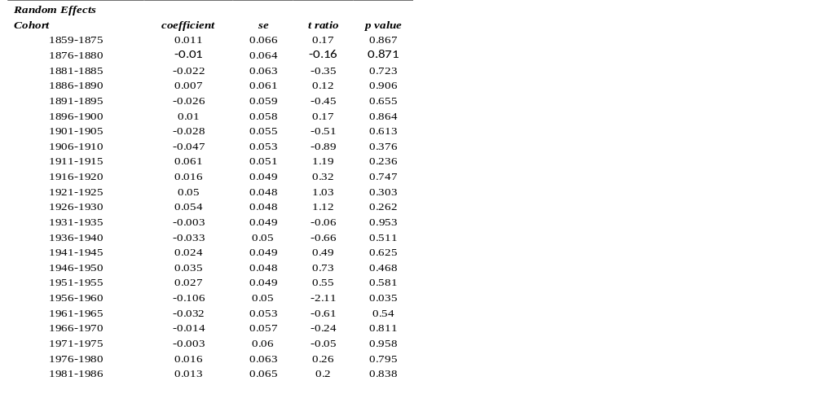

Slide 74
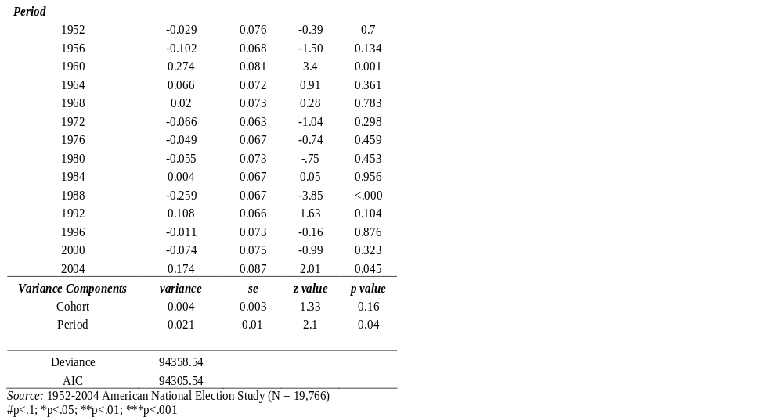

Slide 75
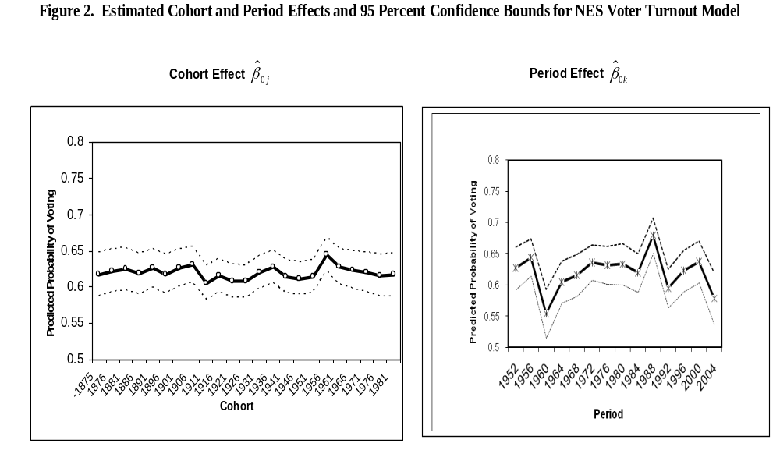

Slide 76
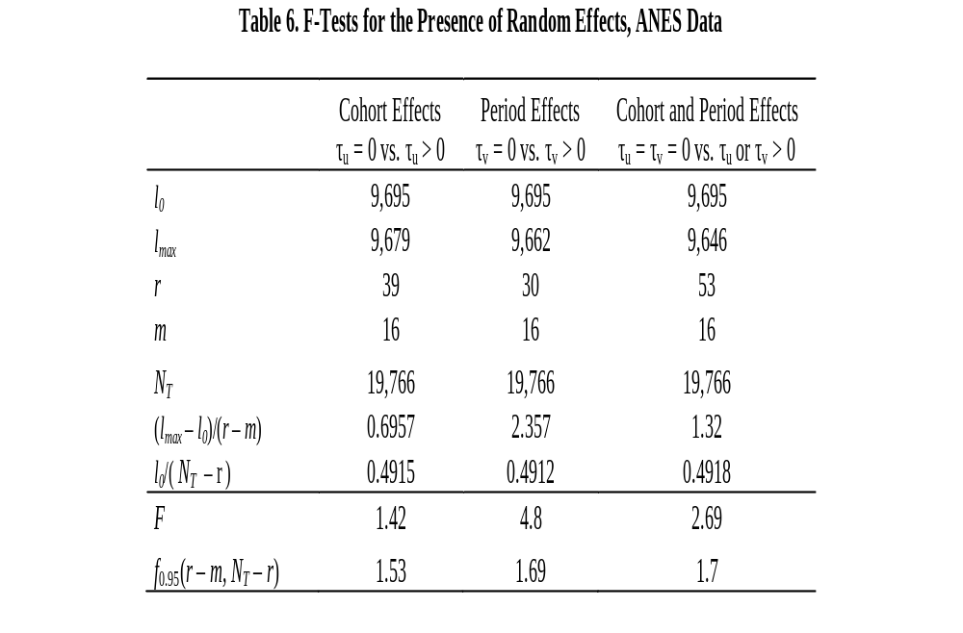

Slide 77
Part III: Second Research Design: APC Analysis of Repeated Cross-Section Surveys
As in the case of trends in GSS verbal ability, this analysis of Presidential voting turnout finds:
  significant random variance components that reside in all three levels of the APC data: individuals nested within cohorts and periods;
  quadratic age effects that are not explained away by controlling for the effects of individual characteristics, and for period and cohort effects;
  significant contextual effects of cohorts and periods on voting in Presidential elections;
  but Presidential voting turnout is mainly a period story.

Slide 78
Part III: Second Research Design: APC Analysis of Repeated Cross-Section Surveys
Application 3: A HAPC-GLMM Analysis of GSS Data on Happiness, 1972-2004 (Yang 2008)
Research Questions:
Who is happier? – Social stratification of subjective well-being
Do people get happier with age and over time?
How do social inequalities in happiness vary over the life course and
by time?
Born to be happy? Are there any birth cohort differences in happiness?

Slide 79
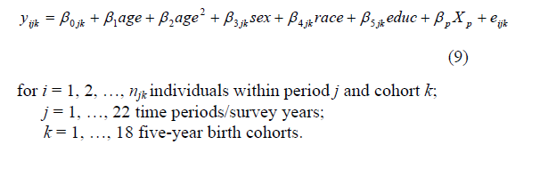
Part III: Second Research Design: APC Analysis of Repeated Cross-Section Surveys
Level 1 (Individual-Level) Model:
where y_{ijk} denotes the ordinal response happiness variable in the GSS data (very happy, pretty happy, not too happy) modeled with an ordinal logit HAPC-CCREM specification, and
X_{p} denotes a vector of other individual-level variables such as age by sex, age by race, and age by education interaction variables.

Slide 80
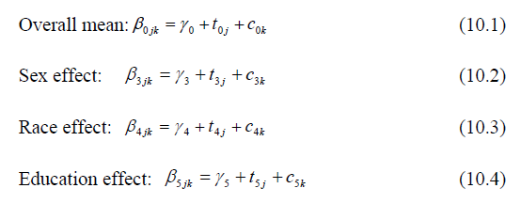
Part III: Second Research Design: APC Analysis of Repeated Cross-Section Surveys
Level 2 Model:

Slide 81
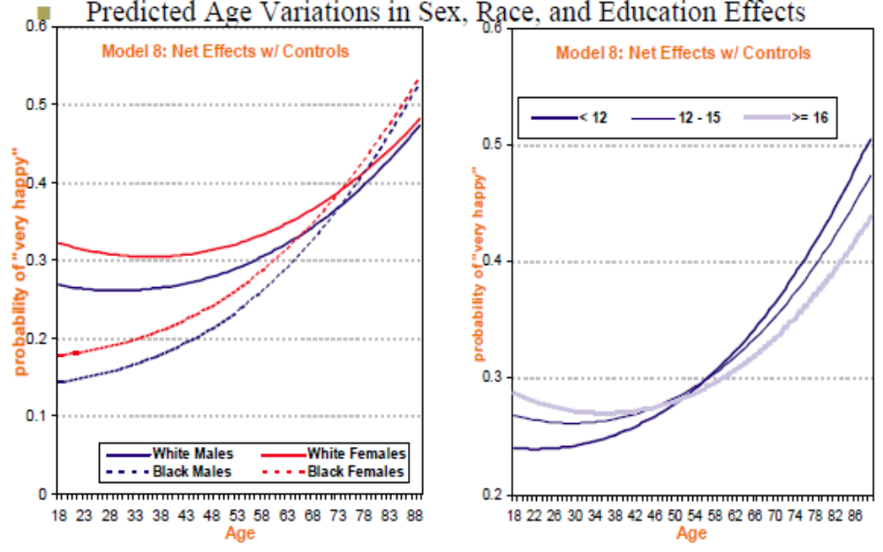
Some Findings:

Slide 82
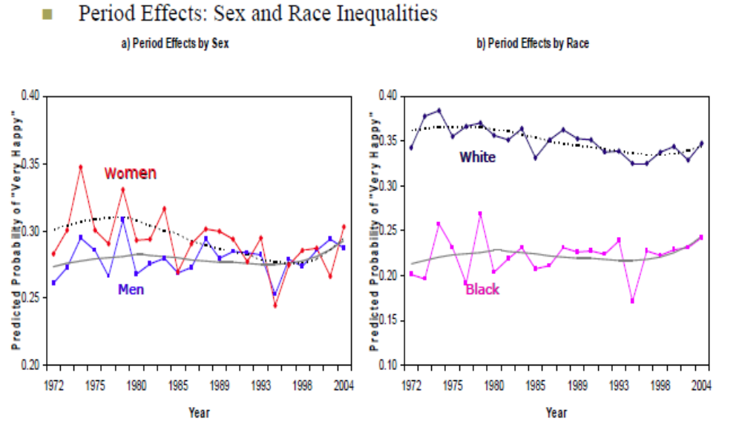
Some Findings:

Slide 83
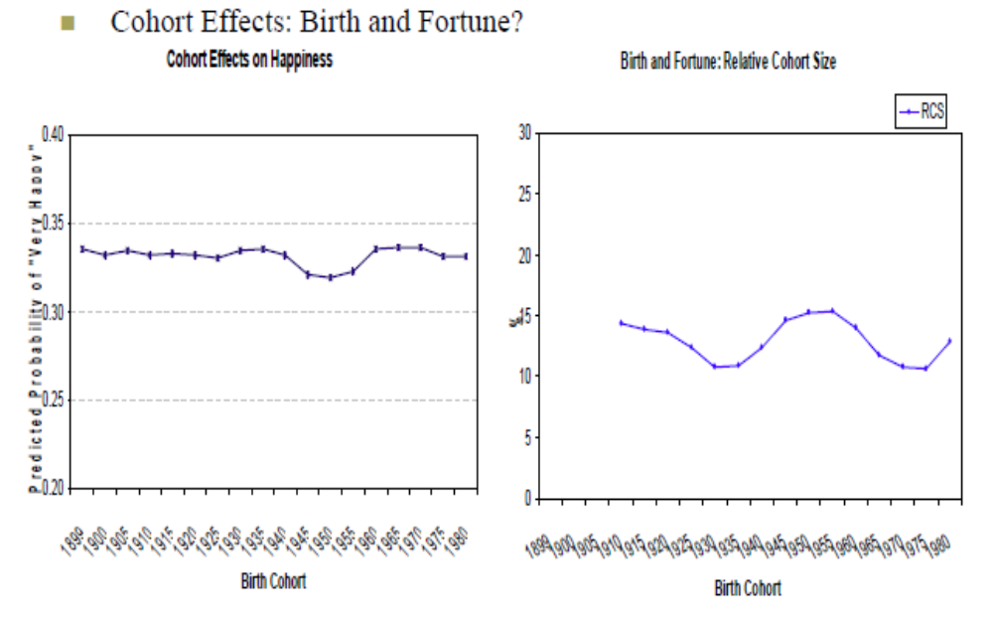
Some Findings:

Slide 84
Part III: Second Research Design: APC Analysis of Repeated Cross-Section Surveys
As in the case of trends in GSS verbal ability and NES Presidential election voting probabilities, this analysis of the GSS happiness data finds:
  significant random variance components that reside in all three levels of the APC data: individuals nested within cohorts and periods;
  quadratic age effects that are not explained away by controlling for the effects of individual characteristics, and for period and cohort effects;
  significant contextual effects of both cohorts and periods on voting in Presidential elections, i.e., interesting stories both for cohorts and periods.

Slide 85
Part III: Second Research Design: APC Analysis of Repeated Cross-Section Surveys
Application 4: An Integration of the Hierarchical Age-Period-Cohort Model with Heteroscedastic Regression to Develop the HAPC-HR Model, Applied to Study Variations in Self-Reported Health Disparities in the U.S., 1984-2007 (Zheng, Yang, and Land 2011)
There are three standard approaches to the study of changes in health disparities:
(1) across the life course (e.g., House et al. 1994; Dannefer 2003),
(2) across cohorts (e.g., Lynch 2003; Warren and Hernandez 2007), and
(3) across time periods (e.g., Pappas et al. 1993; Goesling 2007).

Slide 86
All of these approaches have one thing in common:
They focus on changes in health disparities as estimated by conditional expectation functions (regressions) estimated on the basis of measured demographic and socioeconomic covariates.
This facilitates the estimation of between-group disparities, i.e., variations in health across groups or between-cell variation and temporal variations therein,
but
it ignores possible within-group disparities – variations in health inside groups or within-cell variation – and variations therein over time.

Slide 87
To examine Age-Period-Cohort variations in both health and health disparities, we:
intersect the HAPC model
with
a Heteroscedastic Regression (HR) model.
This allows us to both:
(1) disentangle age, period, and cohort effects, and
(2) separate within-group health disparities from between-group health disparities.
The result is a Hierarchical-Age-Period-Cohort-Heteroscedastic-Regression Model (HAPC-HR) model.

Slide 88
Application to National Health Interview Survey (NHIS) data on self-reported health, 1984-2007: With individual-level demographic and socioeconomic that are established covariates of health used to define the cells in the Level-1 regression model:
sex (1 = male, 0 = female),
race (1 = white, 0 = non-white),
marital status (1 = married, 0 = unmarried),
work status (1 = full/part time job and 0 = not employed),
education (years of formal education), and
income (in 2007 dollars),
here are some results.

Slide 89
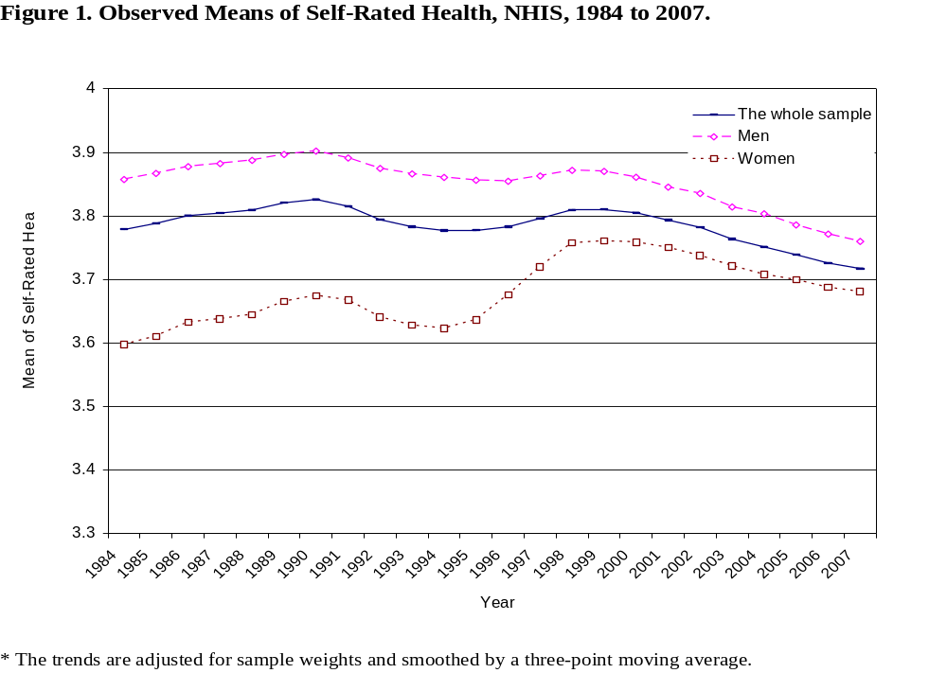

Slide 90
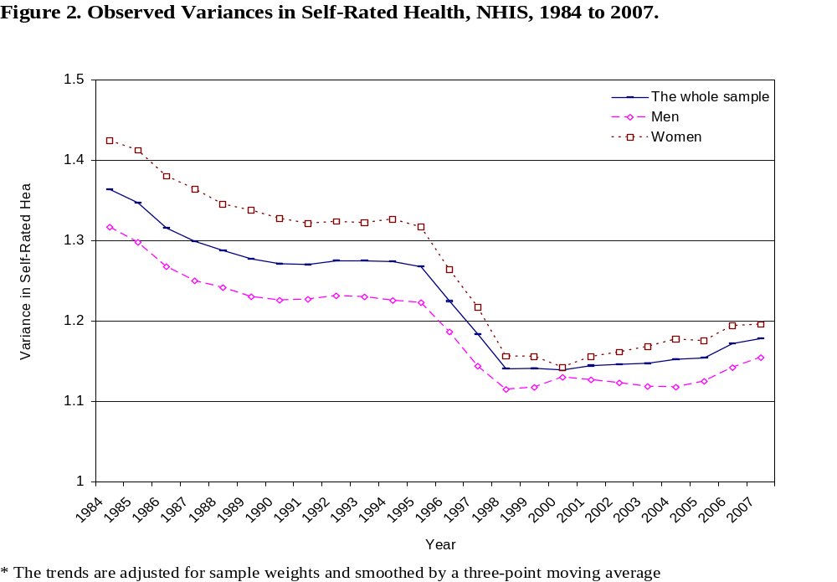

Slide 91
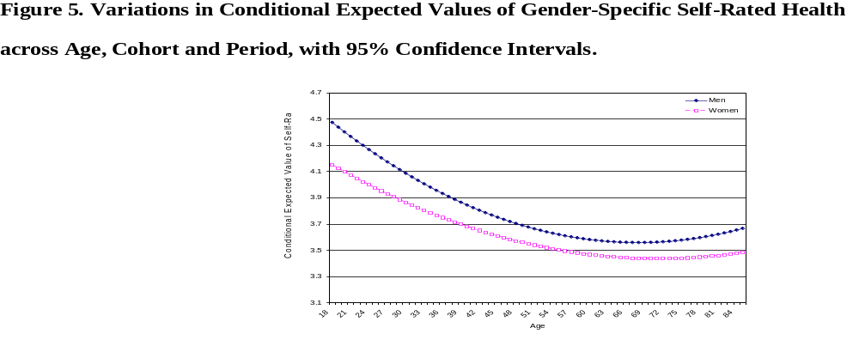
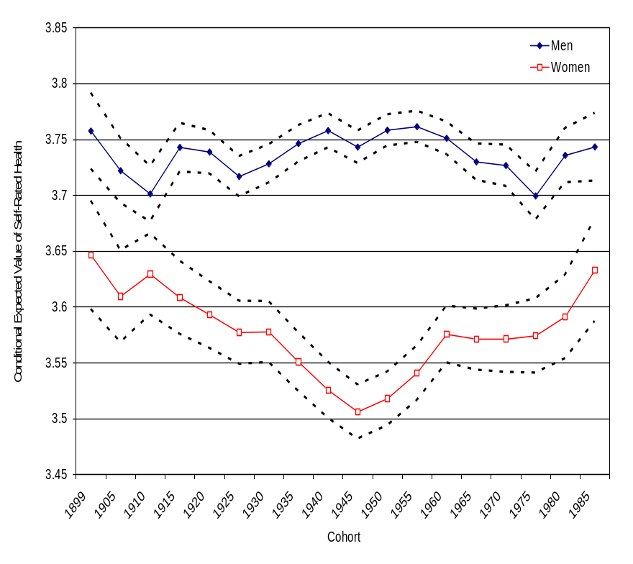
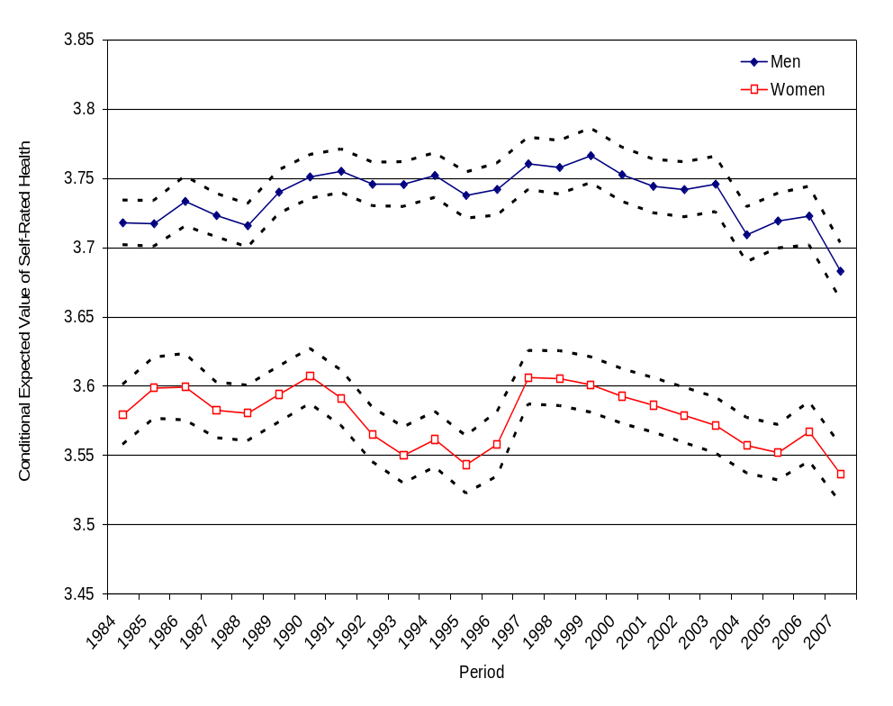

Slide 92
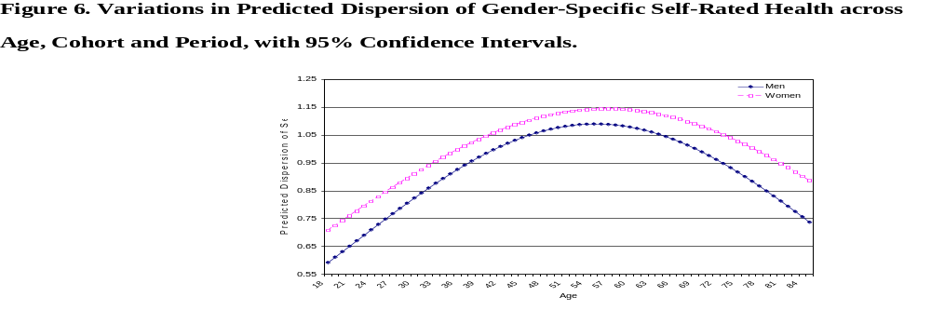
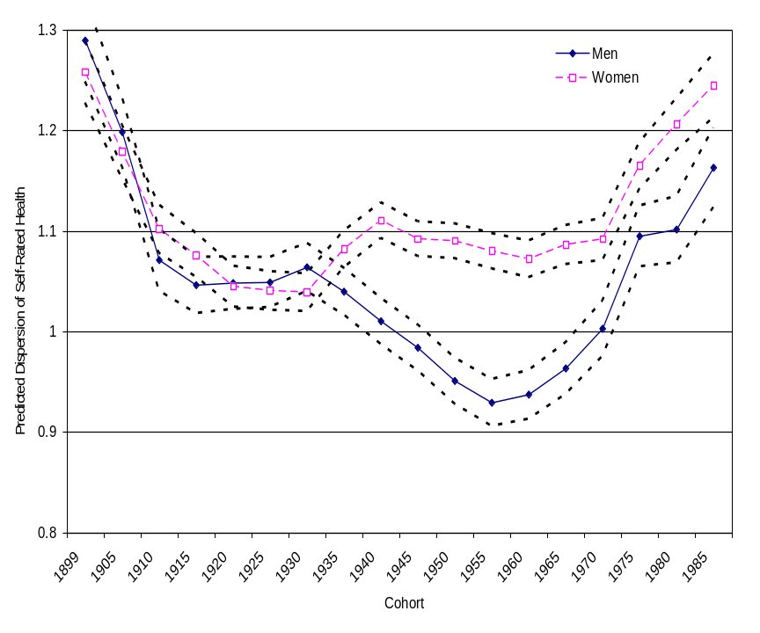
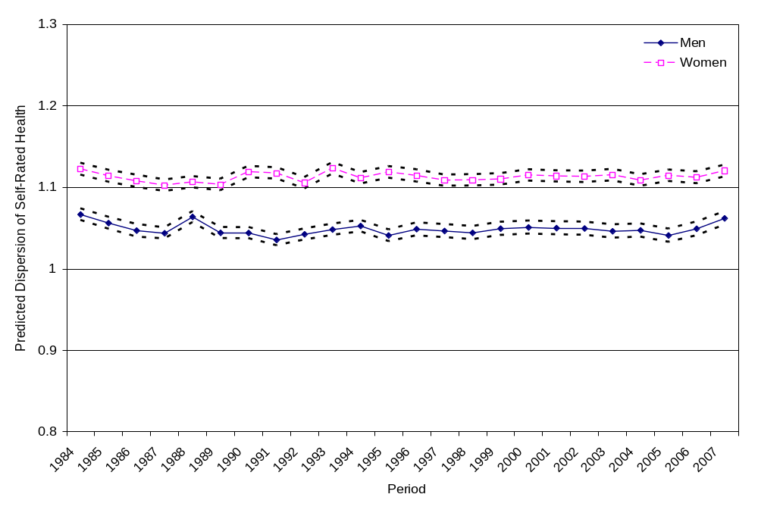

Slide 93
Part IV: Third Research Design: Cohort Analysis of Accelerated Longitudinal Panels
References for Part IV:
  Miyazaki, Yasuo and Stephen W. Raudenbush. 2000. "Tests for Linkage of Multiple Cohorts in an Accelerated Longitudinal Design." Psychological Methods 5:44-63.
  Yang, Yang. 2007. “Is Old Age Depressing? Growth Trajectories and Cohort Variations in Late Life Depression.” Journal of Health and Social Behavior 48:16-32.

Slide 94
Part IV: Third Research Design: Cohort Analysis of Accelerated Longitudinal Panels
Accelerated Longitudinal Panel Design
  Definition: A longitudinal panel study of an initial sample of individuals from a broad array of ages (and thus birth cohorts) interviewed or monitored with three or more follow-up waves.
  The design allows a more rapid accumulation of information on age and cohort effects than a single cohort follow-up study.

Slide 95
Part IV: Third Research Design: Cohort Analysis of Accelerated Longitudinal Panels
Data Structure: Accelerated Longitudinal Panel Design
Age (Time)
Cohort
Notes:
Many studies such as those in life course and aging involve panel designs that follow multiple cohorts over time, as shown by the diagram. The example shown here follows 4 cohorts for 4 time points, the columns represent their ages at each measurement.

Slide 96
Part IV: Third Research Design: Cohort Analysis of Accelerated Longitudinal Panels
For this research design, the HAPC Model becomes a Growth Curve Model of Individual Change with cohort interactions:
  Assess the intra-individual age changes and birth cohort differences simultaneously;
  Assess differential cohort patterns in age changes: age-by-cohort interaction effects;
  Period effects?
    The time period for an accelerated longitudinal panel study often is short (e.g., a decade or so), so the effects of period usually can be ignored;
    In growth curve models, age and time are the same variable, so the effects of period need not be estimated; and
    can be focused on the age-by-cohort interactions.
    If period effects are of concern, estimate the HAPC-CCREM.
Notes:
A useful tool for longitudinal analysis of individual change is the growth curve models, which is an application of hierarchical models.
It is challenging to estimate a separate period effect in such design because data were usually collected in a comparatively short time. And in growth trajectory models, age and time are the same variable.

Slide 97
Part IV: Third Research Design: Cohort Analysis of Accelerated Longitudinal Panels
Application: Cohort Variations in Age Trajectories of Depression in the Elderly (Yang 2007)
  Research Questions
    Does the age growth trajectory show an increase in depressive symptoms in late life?
    Is there cohort heterogeneity in levels of depressive symptoms and age growth trajectories of depressive symptoms?
    What social risk factors are associated with these effects?
  Data
    Established Populations for Epidemiologic Studies of the Elderly (EPESE) in North Carolina: A four-wave panel study of older adults aged 65+ from 1986 to 1996

Slide 98
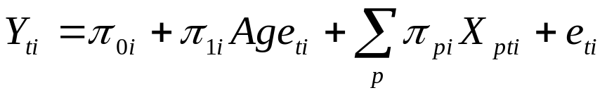




Part IV: Third Research Design: Cohort Analysis of Accelerated Longitudinal Panels
Model Specification
  Level-1 Repeated Observation Model
(11)
Y_{ti} = CES-D for person i at time t, for i =1, …, n and t = 1, …, Ti
X_{pti} = (marital status, economic status, health status,
stress and coping resources)
= expected CES-D for person i
= expected growth rate per year of age in CES-D for person i
= regression coefficient associated with X_{pti}
iid
Notes:
The goal of the analysis is to estimate the overall age trajectory of development of depressive symptoms and multiple trajectories for cohorts.
In the Level 1 Repeated Observations Model, each person’s growth trajectory in CES-D score, Y, is a function of a set of time-varying covariates that include age and X, all continuous variables are centered.
Of central interest are two individual growth parameters: The intercept pi_oi and the rate of increase Pi_1i.
E_ti is the random within-person error for person i at t and is assumed normally distributed with means of 0 and variance sigma^2.
Alternative models such as quadratic age growth models and generalized hierarchical models such as Poisson and negative binomial models have been explored. The results are quite similar with the results from the current models.

Slide 99
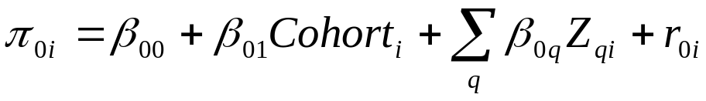






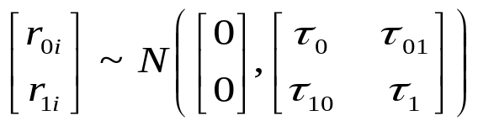
Part IV: Third Research Design: Cohort Analysis of Accelerated Longitudinal Panels
Model Specification
  Level-2 Individual Model
(12)
Z_{qi} = (Female, Black, Education)
= expected CES-D for person i for the reference group (at median age in Cohort 1 at T1)
= main cohort effect coefficient: mean difference in CES-D between cohorts
= regression coefficient associated wit Z_{qi}
= age effect coefficient: expected rate of change in CES-D
= age*cohort coefficient: mean difference in rate of change between cohorts
iid
Notes:
The Level 2 Model specifies a distinct average trajectory for each individual and incorporates other time-invariant covariates associated with each individual.
The individual growth parameters: pi_0 and pi_1, vary by cohort membership and depend on person-level characteristics.
The residual random effects, r_0 and r_1 have a bivariate normal distribution with zero means, and variances tau.

Slide 100



Part IV: Third Research Design: Cohort Analysis of Accelerated Longitudinal Panels
Model Estimates
Fixed Effect | Model 1 (Total) | Model 7 (Net)
Intercept, | 2.856*** | 2.525***
Growth Rate: Age, | 0.048*** | -0.018
Cohort | 0.244*** | -0.213**
Age * Cohort | -0.019# | -0.040***
Random Effect | Variance Component |  | % Reduction
Level-1: Within person | 36.987*** | 35.109*** | 5%
Level-2: In intercept | 6.170*** | 3.763*** | 39%
In growth rate | 0.057*** | 0.051*** | 11%
Goodness-of-fit
AIC (smaller is better) | 51190.5 | 48167.4
BIC (smaller is better) | 51215.6 | 48192.5
# p < .10; * p < .05; ** p < .01; *** p < .001.
Notes:
Model 1 estimates the gross age and cohort effects without controls. The cohort effect is strongly significant and positive. So we are not looking at a pure aging phenomenon because the association does not apply across cohorts. In addition, the age*cohort interaction effect suggests the possibility of cohort-specific age growth trajectory patterns.
The final model includes the explanatory variables and they are all significantly associated with depression. Compared with Model 1, the net effect model shows
The age effect is not significant, cohort effect remains strongly significant, but it switched direction, and age*cohort interaction effect increased.
Controlling for level-1 and level-2 covariates resulted in substantial reductions in the variance components, especially at the person-level. What’s noteworthy is that the variance in the growth rate is reduced by 11% by adding cohort effect alone (i.e. age*cohort interaction).
And the final model fits the data much better.

Slide 101
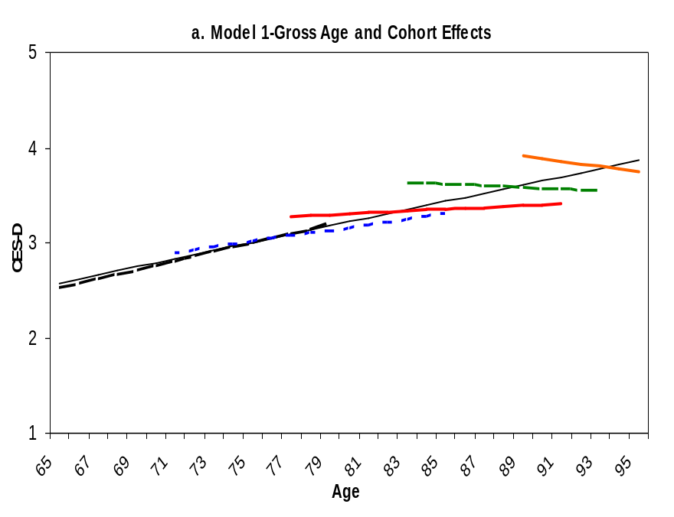
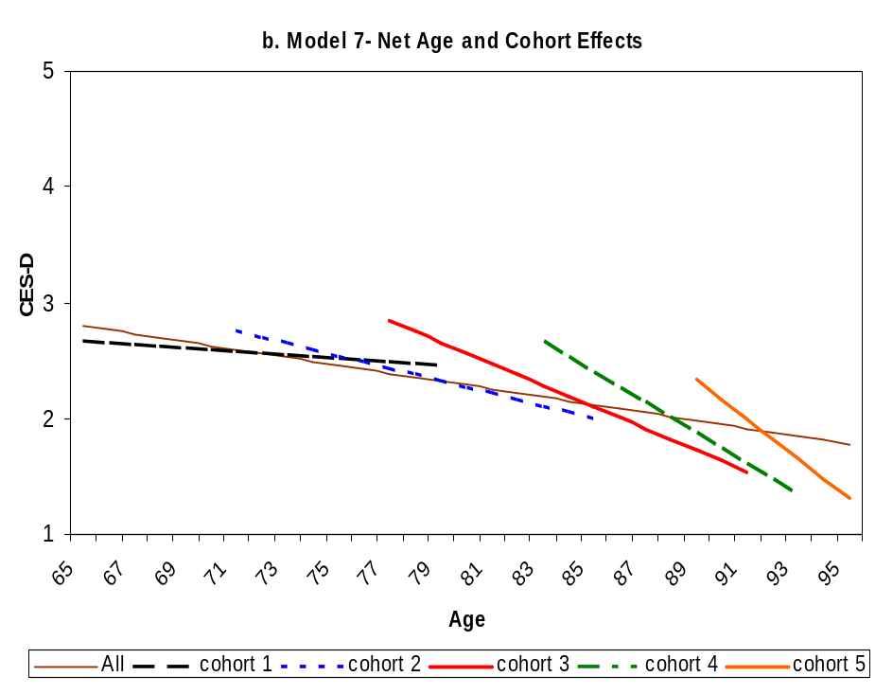
Part IV: Third Research Design: Cohort Analysis
of Accelerated Longitudinal Panels
Expected Growth Trajectories and Cohort Variations in Depression
Notes:
This can be clearly seen in graph a. The overall age trajectory is superimposed on the cohort trajectories from Model 1’. Both the main and interaction effects can be noted:
There is a strong cohort gradient in the average depression levels. The five cohorts had successively higher overall depression;
and age growth rates differ between these cohorts.
Graph b: The predicted growth trajectories from the final model, where we see decreasing depression with age for all cohorts, and the decrease is steeper for older cohorts.

Slide 102
Part IV: Third Research Design: Cohort Analysis of Accelerated Longitudinal Panels
Summary of Findings:
  The gross age trajectory of depressive symptoms during late life is positive and linear;
  There is substantial cohort heterogeneity in both average levels of depressive symptoms and age growth trajectories of depressive symptoms;
  The age growth trajectories of depressive symptoms are not significant after adjusting for cohort effects and risk factors associated with historical trends in education, life course stages, survival, health decline, stress and coping resources;
  Net of all the factors considered, more recent birth cohorts have higher levels of depression.

Slide 103
Conclusion
A Webpage has been developed that contains copies of our papers referenced in this presentation as well as others:
http://www.unc.edu/~yangy819/apc/index.html
Happy Hunting for Age, Period, and Cohort Effects!

